Slide 1

Movie-Flix
MENTORS : SRINIVAS PATTANAIK, ALI HUSHNOON BANU
Presented by : Nihal Mujawar, Muskan Ramchandani

Slide 2



Team-Mates

Slide 3
Objective
To create an user-friendly interface that allows users to easily search, and access information about movies, including details, reviews, trailers.

Slide 4
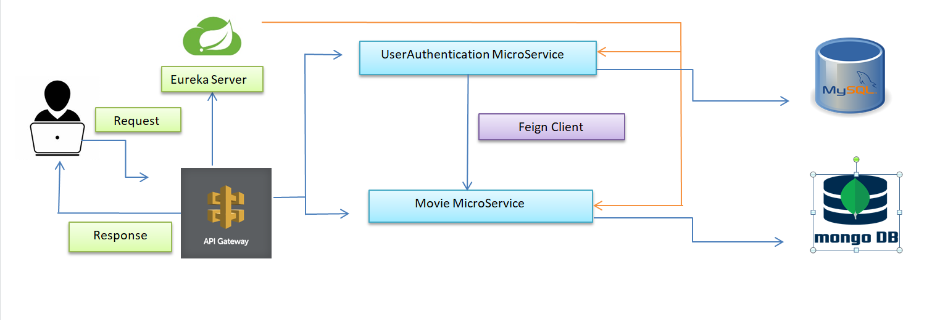
ARCHITECTURE DIAGRAM

Slide 5
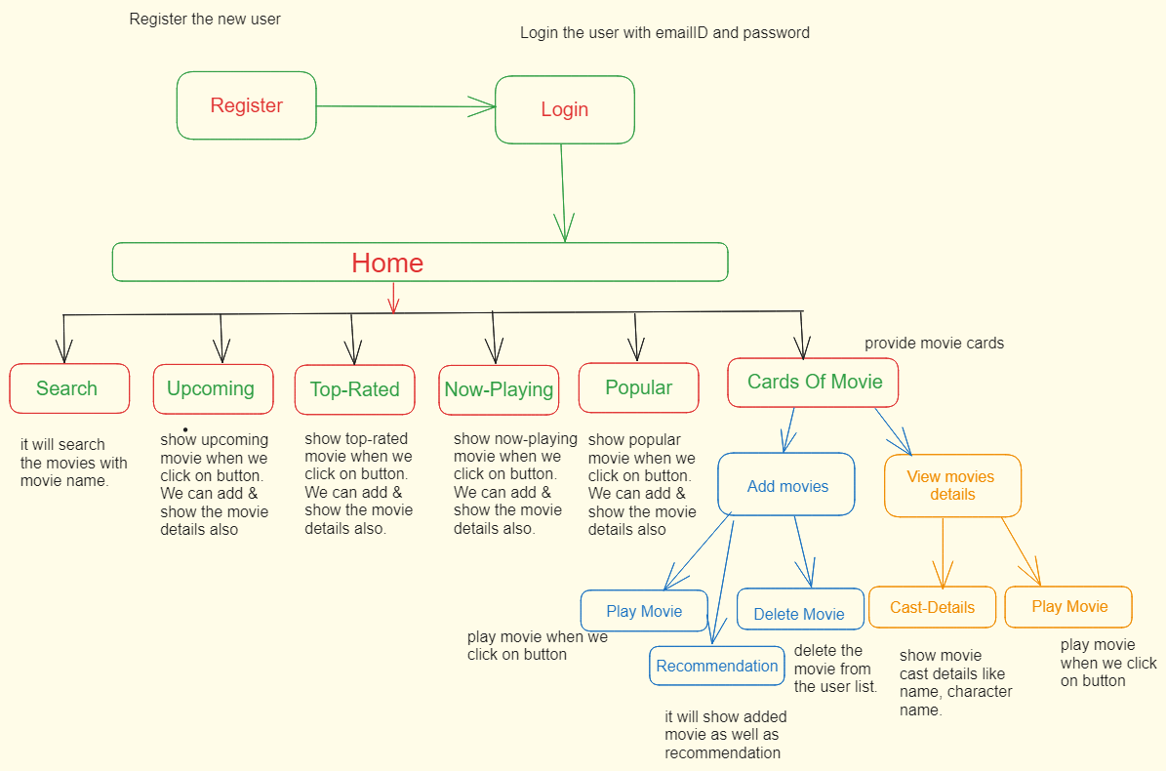
WORKFLOW DIAGRAM

Slide 6
TECHNOLOGIES
Spring Boot for the java backend structure
Database – MongoDb and MySQL
Angular framework to make the Front-end web application using HTML , Typescript , Bootstrap, CSS and Angular material.
Feign-Client for synchronous communication between microservice
Eureka server for monitoring microservices and Api-Gateway for load-balancing and for making single entry point into the application.
Testing-Junit 5 and Mockito

Slide 7
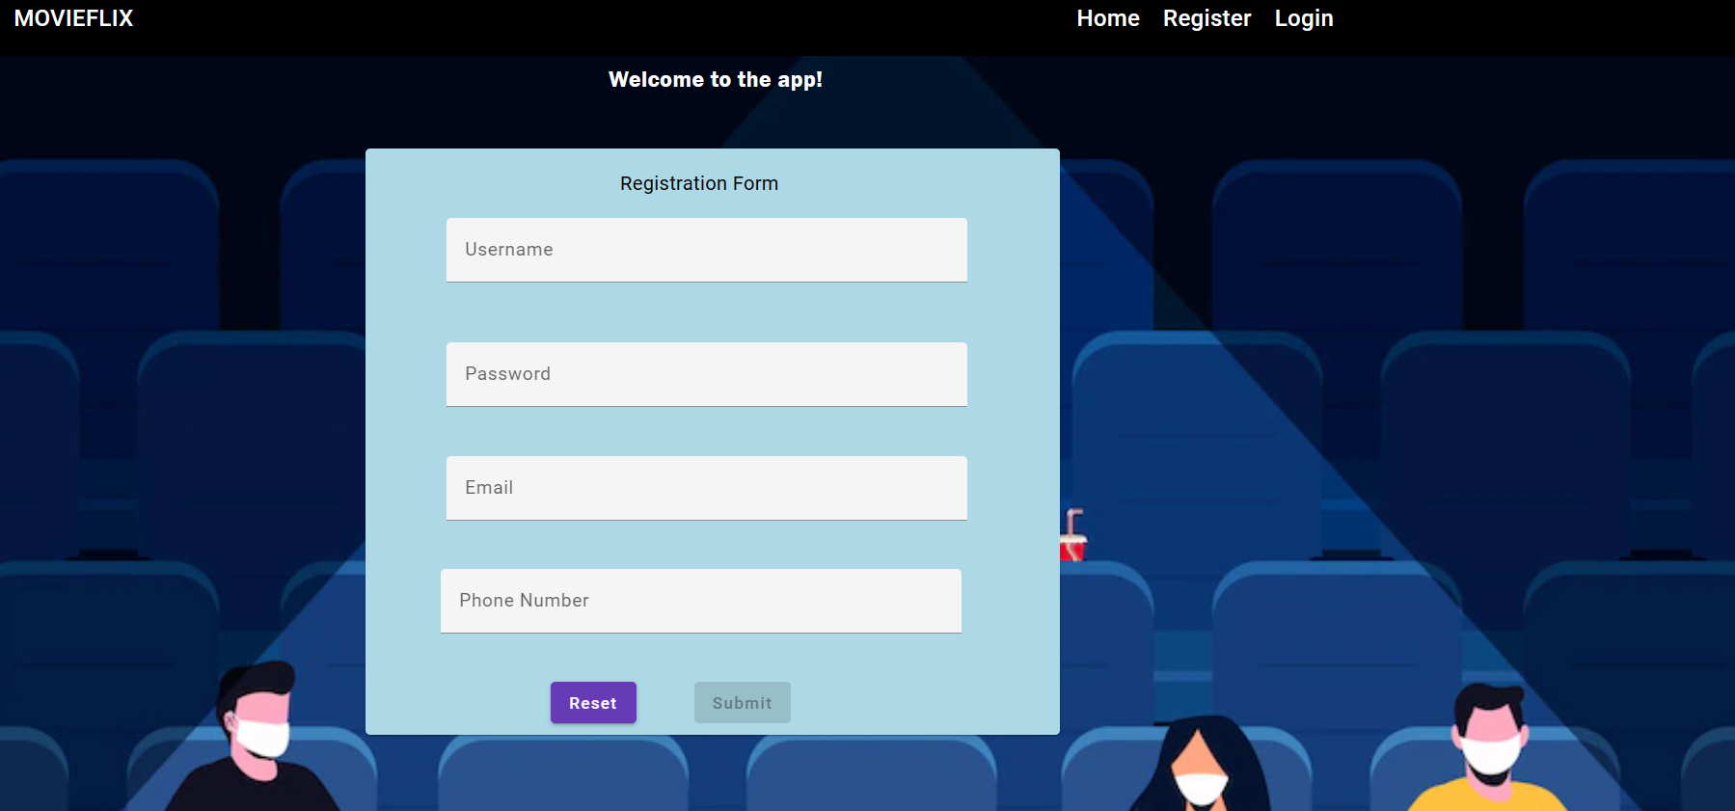
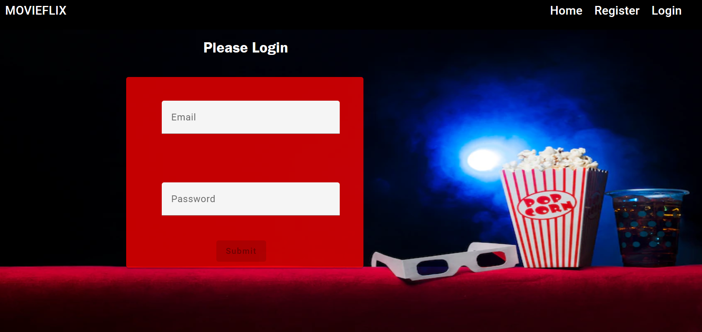
Screenshots of Login and Register page

Slide 8
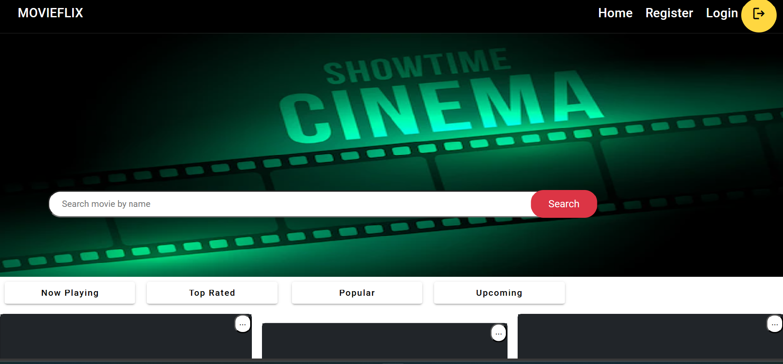
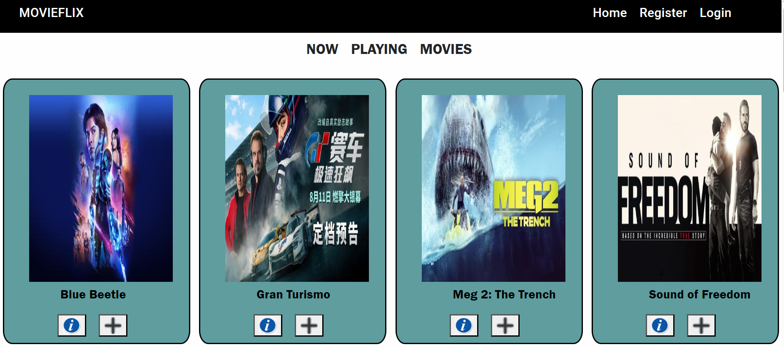
Home page and Now playing movies page

Slide 9
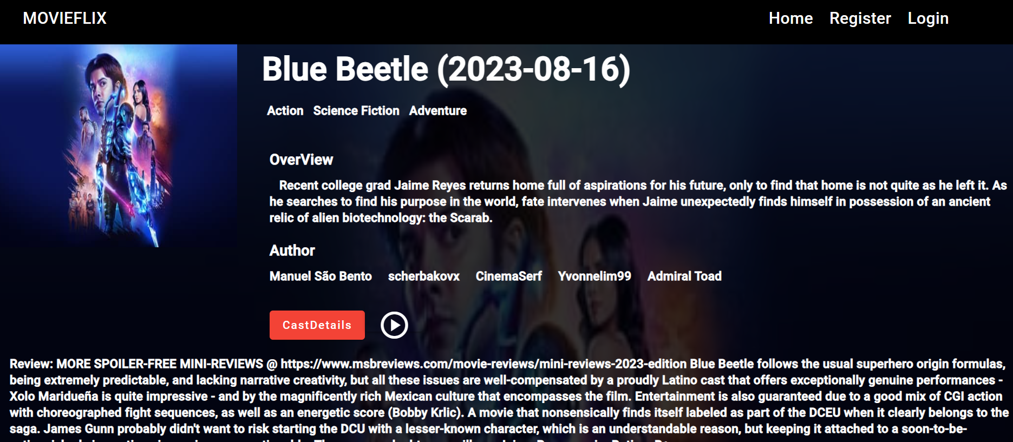
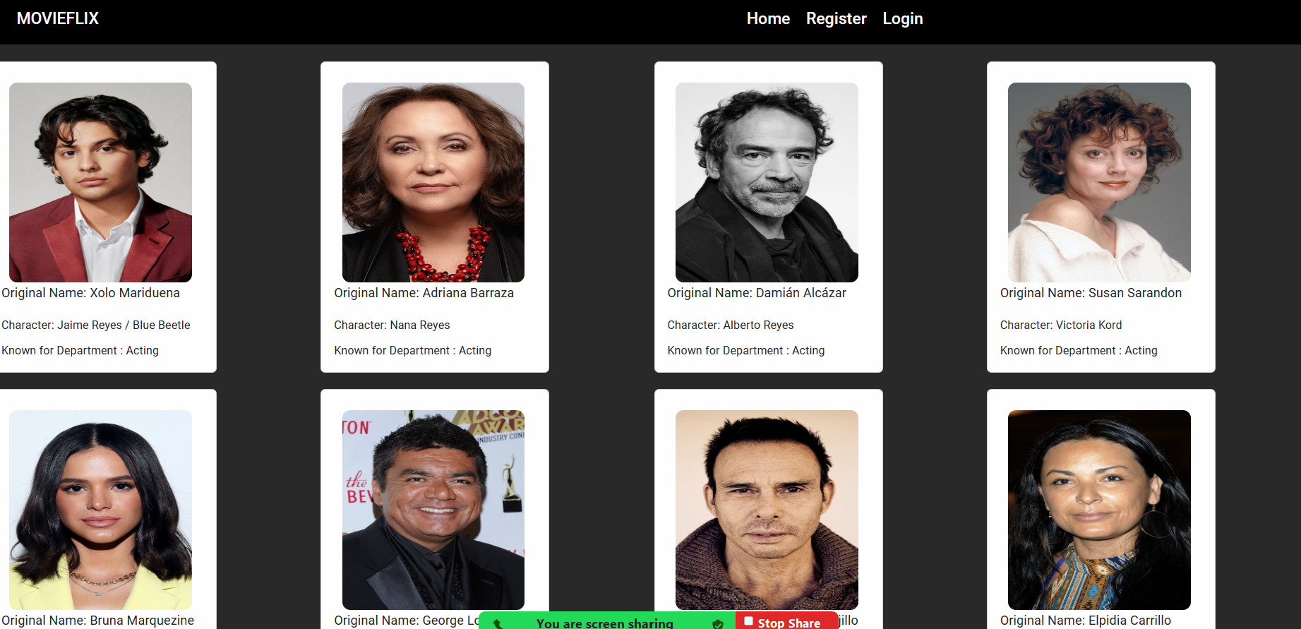
Moviedetails And Castdetails

Slide 10
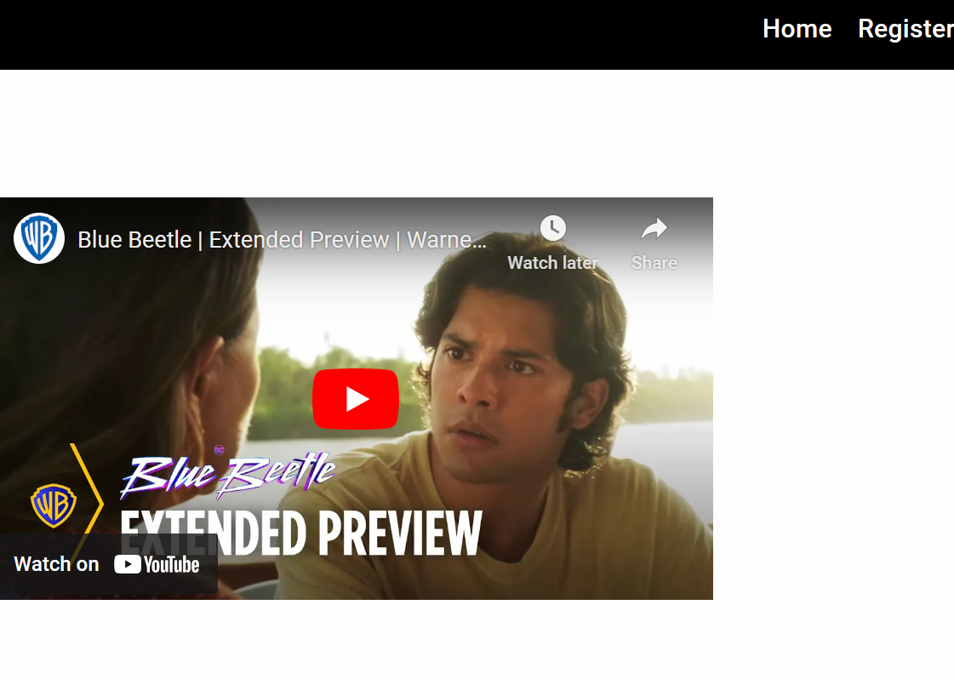
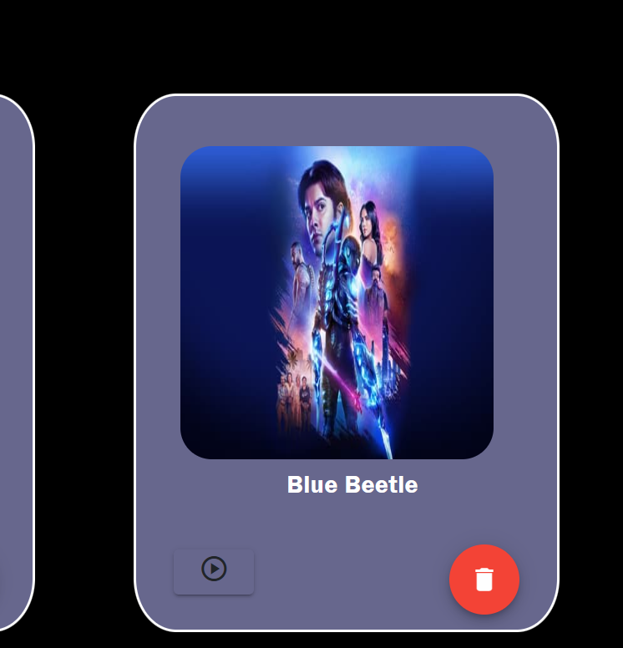
View favorites and video player

Slide 11
Future Enhancement
User Feedback
Offline Support
Dynamic Themes and Dark Mode
Interactive Chatbots

Slide 12



